Slide 1
Controlling within SAP GlobalWay
Year-End Closing
Product costing
At date of January, 12th 2015
Version 01

Slide 2

Agenda
Introduction
5’
Activity types updates
20’
Routing and BOM updates
20’
Product costing
40’
Conclusion
10’

Slide 3

Year-End Closing Product costing – Introduction
Overview
The Year-End closing for controlling is mainly related to product costing.
The normal steps of a period-end closing are expected too.
The controlling steps for the year-end closing will enable the production process to take place starting on January the 1rst at 00:00.
Routings and Bill of Material updated
Activity types revaluation per cost center
Standard prices updated for the new year
To be completed

Slide 4
Agenda
Introduction
5’
Activity types updates
20’
Routing and BOM updates
20’
Product costing
40’
Conclusion
10’

Slide 5
Activity types revaluation
The activity types are :
Valuated at the cost center level
Assigned to each work center
Used for the standard price calculation process
Used on a daily basis for the actual price calculation for each PP order confirmation
Planned for the full year – a modification in the activity types during the year should remain exceptional and caution to Raygroup validation
There are various ways to update activity types valuation:
Copy the activity type price from the previous fiscal year
Enter them manually per cost center and activity type
Enter them through Excel integration
Once entered in the system, it is important to check the completeness and the correctness through a dedicated reporting transaction.
Ask your local Controller for any additional information on the activity type valuation that have been updated within your scope.

Slide 6

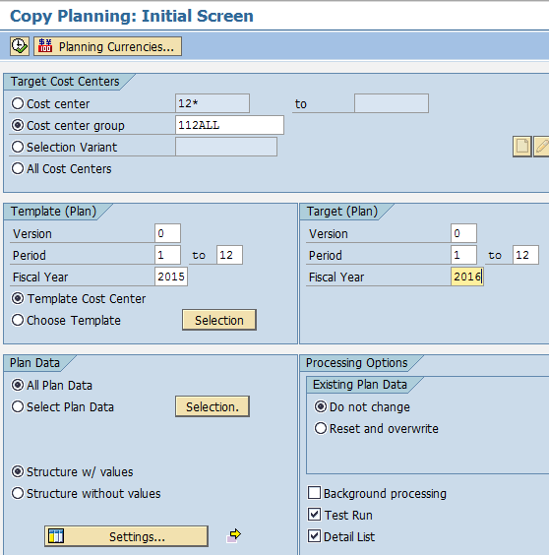
Activity type Copy previous year (1/2)
Transaction KP97: Copy planning
For the PRDH, LABOUR, MTMAINT, MTAMORT, SETUP, this option is available
Selection screen
1
Cost center group
Source:
Version: 0 is the only one used
Period: from 1 to 12
Fiscal year
2
1
Each cost center planned values are copied to same cost center in the target version, period and year
3
4
4
Target version, period and fiscal year
2
It is possible to copy all the planned data or to focus on the activity types for example
3
5
7
Restrict copy to the activities
5
6
8
8
Option for existing planned values
9
Execute in mode first
9

Slide 7
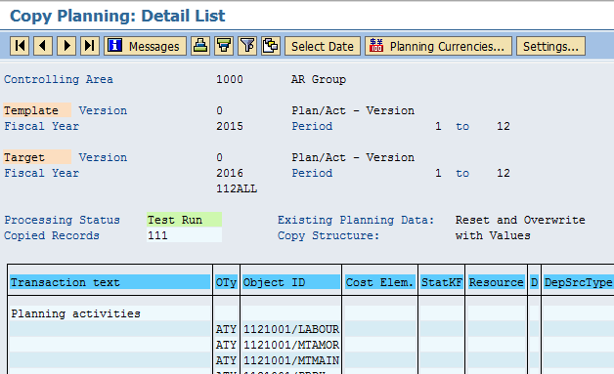
Activity type Copy previous year (2/2)
Transaction KP97: Copy planning
The list of cost centers and activity types that are copied, are listed in the detailed list
Display screen
1
2
3
5
6
1
Once validated, go back to the selection screen and execute the copy without the test mode
Once entered, checked the entered values with the dedicated activity types prices per cost center report.

Slide 8
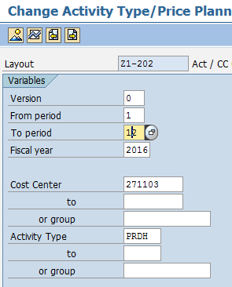
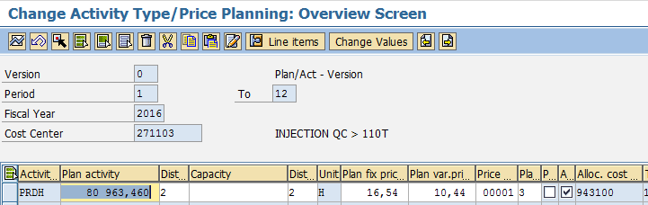
Activity type planned price – Display/Change
Transaction KP26: Change activity type valuation
For most companies, the activity types are calculated manually outside of the system.
Selection screen
1
Select the periods from 1 to 12 and year
2
Select the cost center and activity type
Display screen
1
2
3
4
5
3
Planned activity per period – distributed equally between periods
4
Planned fixed price
5
Planned variable price
Activity type should not be revaluated during the year.
This option could though be used when the activity types form LABOUR or PRDH or any activity type within a routing is obviously under or over valuated… with major impacts on the product costing.

Slide 9
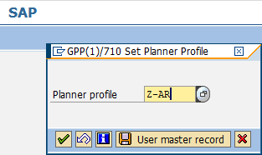
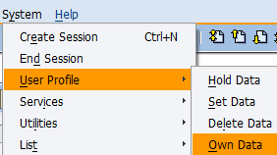
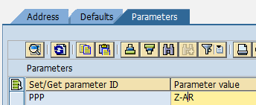
Activity type planned price – Excel integration
Transaction KP04: Change planner profile
The planner profile will allow the planning layout for Excel integration.
Selection screen
1
Select the Planner Profile
1
2
Save the Planner Profile in your user master record
2
3
4
4
4
Save the Planner Profile in your user parameters
This planner profile is the one to be used for Excel integration or for manual planning.
Enter the planner profile Z-AR as your defaulted value. Once done this step is not relevant anymore.

Slide 10
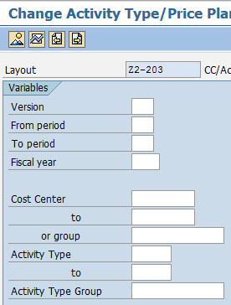
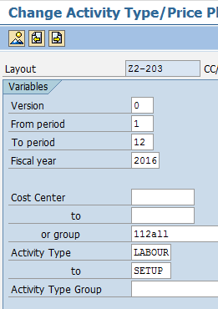
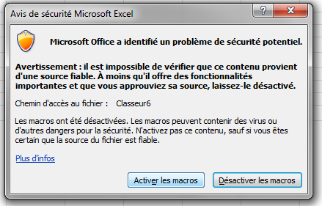
Activity type planned price – Excel integration (1/3)
Transaction KP26: Change activity type valuation
Select the layout dedicated to Excel integration
Selection screen
1
Drill towards the layout where the option is not available. This layout is dedicated to Excel integration
1
2
Select the cost center and activity types from LABOUR to SETUP
3
Activate the Excel entry screen
3
2
4
Open Excel and activate the macros
2
2
4
The current values for the selected cost centers and activity types are displayed in the Excel format.
Do not delete or add columns, or lines… or you will face issues during the Excel update into SAP.

Slide 11
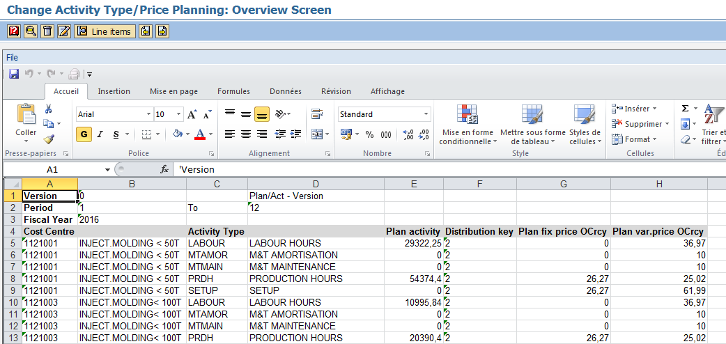
Activity type planned price – Excel integration (2/3)
Transaction KP26: Change activity type valuation
From the extraction, update the values using Excel functions…
Display screen
1
1
Copy and past the values from SAP to an Excel file without inserting or deleting lines or columns

Slide 12
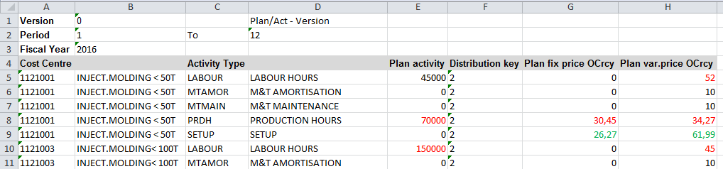
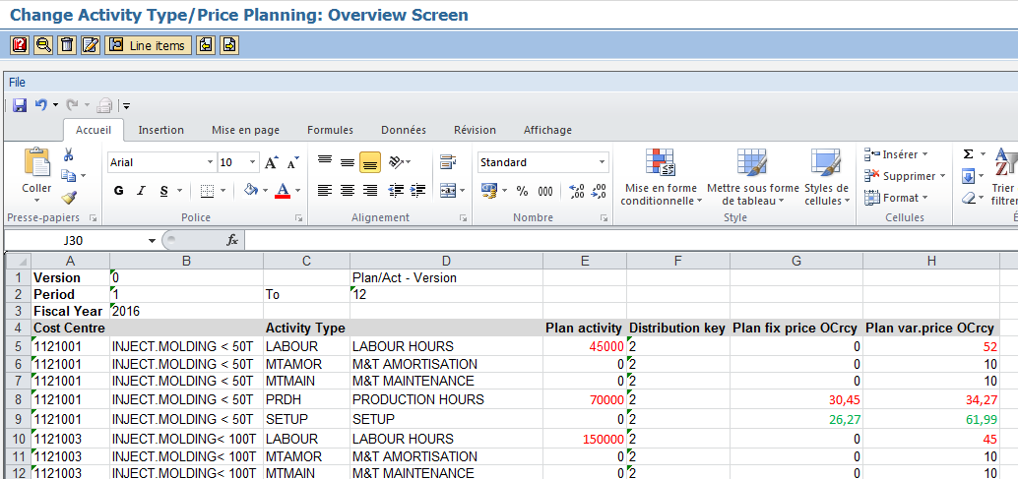
Activity type planned price – Excel integration (3/3)
Transaction KP26: Change activity type valuation
From the extraction, update the values using Excel functions…
Display screen
1
Update the values in Excel (and save the file for safety…) from your calculation.
Copy and paste functions are possible
Formatting (colors, fonts updates) are possible
Do not delete a column or a line unless you will face issues during the integration
1
3
2
Paste the updated values in SAP.
3
Save the updated values in SAP.
Once entered, checked the entered values with the dedicated activity types prices per cost center report.

Slide 13
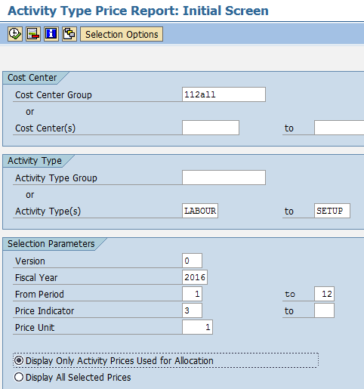
Activity type planned price – report (1/2)
Transaction KSBT: Activity type price report
Control the activity type prices for the full year or for a single period
Selection screen
6
1
Select the cost center group
2
Select the activity types from LABOUR to SETUP
1
Source:
Version: 0 is the only one used
Period: from 1 to 12
Fiscal year
3
2
4
Select the price indicator 3 for the manual entries
3
5
Display only the activity types relevant
6
Execute
4
5
When facing issues with the activity types valuation, this report can be executed for a single month selection.
Executed for a longer range, the average valuation is calculated.

Slide 14
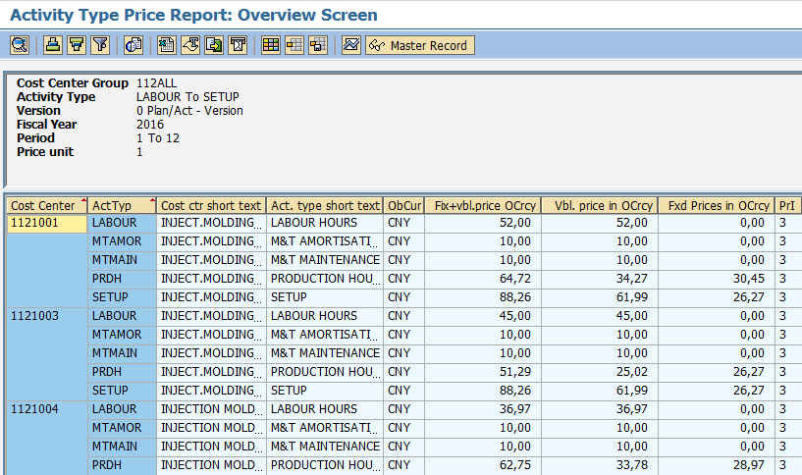
Activity type planned price – report (2/2)
Transaction KSBT: Activity type price report
Control the activity type prices for the full year or for a single period
Selection screen
1
1
Check fixed and variable prices
In this example, the Variable price entered for Cost center 1121001 and activity type LABOUR has been updated from its original value to 52 CNY.

Slide 15
Agenda
Introduction
5’
Activity types updates
20’
Routing and BOM updates
20’
Product costing
40’
Conclusion
10’

Slide 16
Year-End Closing Production orders – Introduction
Routing – 6 activities valuated within the Routings
1
Activity consumption
SETUP: Fixed quantity
PRDH: per base quantity
LABOUR: per base quantity
Subcontracting: Purch. Ord
MTAMORT: confirmation Std
MTMAINT: confirmation Std
a
PP Prod orders
SF / Finished
Production
b
Routing
c
d
Material consumption
Including Backflush cons.
Co-Products
Production of Coproducts
2
Bill Of Material
1
Within the Production information system, the activities are sorted in the listed order
a
Set Up: a fixed quantity whatever the produced quantity – manual confirmation
b
PRDH and LABOUR:
In the routing, the quantities are defined per base Quantity
Theoretical quantity = (Yield + Scrap) / Base Quantity
Confirmation of the actual quantity for the whole operation
c
Subcontracting: valuated from Subcontracting purchase orders – non confirmation within the operation
d
M&T Amortization, M&T Maintenance: confirmation is automatically done at the standard quantity

Slide 17
PP Production Orders – Impacts from the routing
The Production information system is aligned with controlling
PP Production orders
Prod CC
Raw Cons.
500
Salaries
2
5 000
1
2 000
943105 SetUp H
Other costs
200
a
943100 Prd H
b
943105 SetUp H
200
a
2 000
943110 Lab H
943100 Prod H
2 000
b
1 500
b
Act type cons
Prod, Set Up, Labor, MTAMORT, MTMAINT
943110 Labor H
1 500
b
943130 Amort
100
d
943130 Amort UA
100
d
943140 Maint
200
d
943140 Maint UA
200
d
432000 Subc.
1 500
c
a
Set Up: a fixed quantity whatever the produced quantity – manual confirmation
b
PRDH and LABOUR:
In the routing, the quantities are defined per base Quantity
Theoretical quantity = (Yield + Scrap) / Base Quantity* Standard value
Confirmation of the actual quantity for the whole operation
c
Subcontracting: valuated from Subcontracting purchase orders – non confirmation within the operation
d
M&T Amortization, M&T Maintenance: confirmation is automatically done at the standard quantity
The production information system with the details by operation provides the figures dedicated to compare the theoretical quantities and the actual ones.
For the PP activity types, the rates are defined for the year. The variance, when existing, is due to quantity variance.

Slide 18
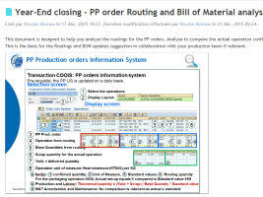
Analysis and related steps
Within the Production Information system, it is possible to compare actual and theoretical value per:
Production order operation
Detailed by activity type (one of the 6 activity types)
The standard quantities are defined per Base quantity.
The actual quantities include both the delivered and the scrap quantities
The comparison Standard versus actual must be done aligning the Base quantities with the delivered ones.
This comparison is detailed in here

Slide 19
Agenda
Introduction
5’
Activity types updates
20’
Routing and BOM updates
20’
Product costing
40’
Conclusion
10’

Slide 20
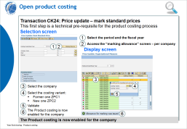
Year-End Closing Product costing
A detailed document is dedicated to Product costing in itself
The controlling steps for the year-end closing will enable the production process to take place starting on January the 1rst at 00:00.
Routings and Bill of Material created or updated
Activity types revaluation per cost center
Raw material planned price updated
Finished goods Standard prices updated for the new year
This document puts the emphasis on the standard price:
Activation for a company or also called Allowed
Calculation
Valuation which is structured into a 2-step process
  Future standard price update or also called Mark
    The future standard price is then available in the material master
  Activation of the new standard price or also called Release
    The new standard price is then used for the stock revaluation
You’ll find details related to the Product costing steps in the document

Slide 21
Agenda
Introduction
5’
Activity types updates
20’
Routing and BOM updates
20’
Product costing
40’
Conclusion
10’

Slide 22

Next steps… to be completed together

